Slide 1
IBM University Engagement Project Submission
“Exploring the Power of Agentic AI with IBM Granite and LangFlow”
The Daily Air Quality Action Agent

Slide 2

Project Tile –The Daily Air Quality Action Agent
Domain of Project – Healthcare
Student Name | Recent Passport Photo | Email ID | Mobile number [WhatsApp]
SHERIN MARIAM JIJO |  | sherin.jijo@bvmengineering.ac.in | 8154815156

Slide 3
Problem Statement -
Problem Statement : The Daily Air Quality Action Agent
The Challenge
Air pollution is a major public health crisis, contributing to respiratory issues, climate change, and reduced quality of life. Citizens often receive air quality index (AQI) data, but it is presented in technical formats, making it difficult to understand or translate into daily lifestyle actions. Traditional monitoring systems lack personalized recommendations and proactive alerts.
The Objective
Build an AI-powered Daily Air Quality Action Agent that translates air quality data into actionable insights for citizens, policymakers, and organizations. The solution should:
AQI Data Retrieval (RAG) – Collect and interpret real-time AQI from public APIs, satellite data, or government sources.
Personalized Health Recommendations – Provide daily actionable advice (e.g., avoid outdoor exercise, use masks, keep children indoors) tailored to age, location, and healthconditions.
Predictive Alerts – Forecast poor air quality days, issue early warnings, and suggest preventive measures like adjusting commute or using air purifiers.
Policy & Awareness Insights – Suggest community-level actions (e.g., carpooling, waste reduction) and summarize policy advisories for public awareness.
Multi-Agent System -
AQI Data Agent (fetches & interprets data)
Health Advisory Agent (personalized lifestyle suggestions)
Forecasting Agent (predicts trends & risks)
Community Action Agent (drives awareness campaigns)
Visualization Dashboard – Show daily AQI levels, risk alerts, and recommended actions in a clear and interactive format.

Slide 4
Technology Used
Tech Stack (Mandatory)
I used LangFlow + IBM watsonx.ai + Granite Models(granite-4.0-8b-instruct)

Slide 5
Proposed Solution -
Proposed Solution: AI-Powered Daily Air Quality Action Agent
The proposed solution is a multi-agent AI system built using LangFlow, IBM watsonx.ai, and Granite Models to transform real-time air quality data into personalized health recommendations and actionable insights.
Key Agents:
AQI Data Agent: Retrieves and interprets AQI data from APIs, satellite, and government sources using RAG.
Health Advisory Agent: Provides personalized recommendations based on age, location, and health conditions.
Forecasting Agent: Predicts air quality trends and issues early warnings with preventive measures.
Community Action Agent: Promotes awareness through policy summaries and community-level environmental actions.
Dashboard Features:
Real-time AQI monitoring
Risk alerts and forecasts
Personalized recommendations
Interactive maps and visualizations
Technology Stack: LangFlow | IBM watsonx.ai | Granite Models | Vector Database | Streamlit/React
Outcome: An intelligent air quality assistant that enables proactive health protection, environmental awareness, and informed decision-making.

Slide 6
Langflow component Used -
Chat Input
IBM watsonx.ai Agent
IBM Granite Model (granite-4.0-8b-instruct)
AQI Data Retrieval Component
Vector Database
Chat Output
Dashboard Integration

Slide 7
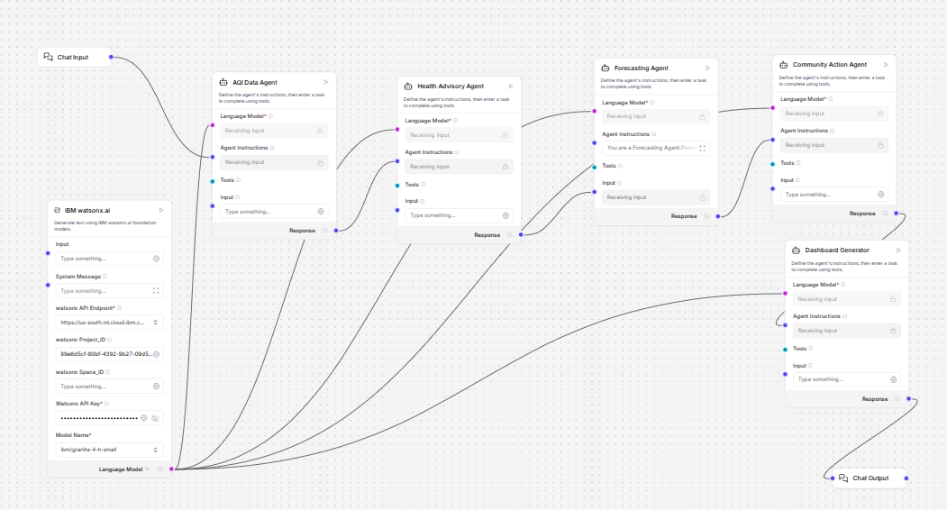
Langflow workflow -

Slide 8
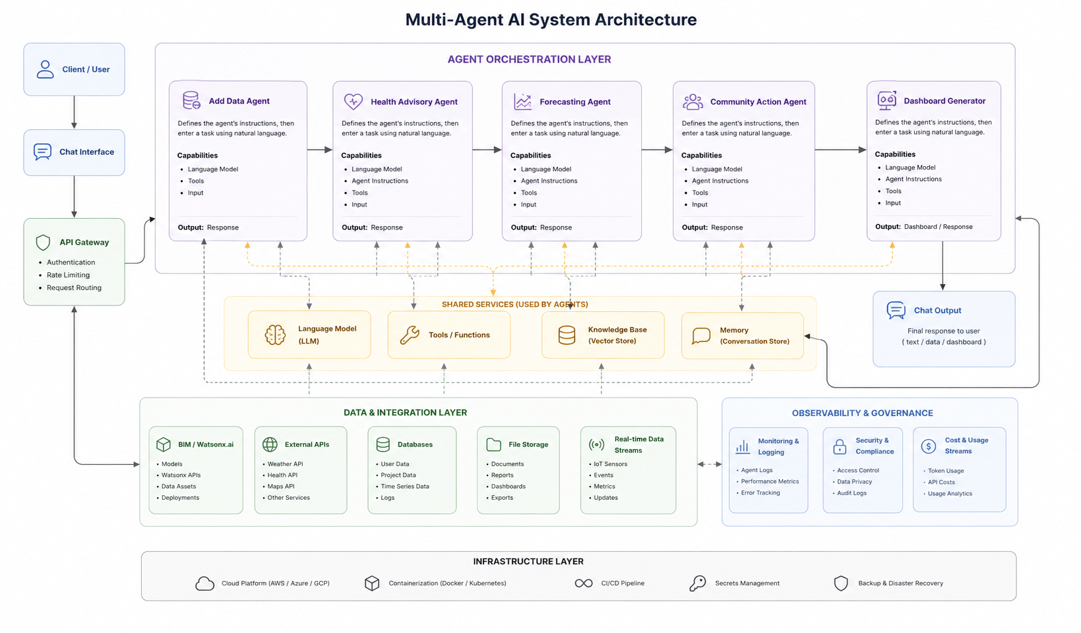
Architecture blueprint

Slide 9

Role of Agentic AI in the solution
Role of Agentic AI in The Daily Air Quality Action Agent
Agentic AI enables autonomous coordination among specialized agents.
AQI Data Agent interprets environmental data.
Health Advisory Agent provides personalized guidance.
Forecasting Agent predicts AQI trends.
Community Action Agent drives awareness and sustainability actions.
Together they create proactive and context-aware recommendations.

Slide 10
Technology Used
LangFlow – Multi-agent orchestration
IBM watsonx.ai – Model deployment & governance
IBM Granite Models – Reasoning & recommendations
RAG – Reliable AQI knowledge retrieval
FAISS/Chroma – Vector storage
Streamlit – Visualization dashboard

Slide 11
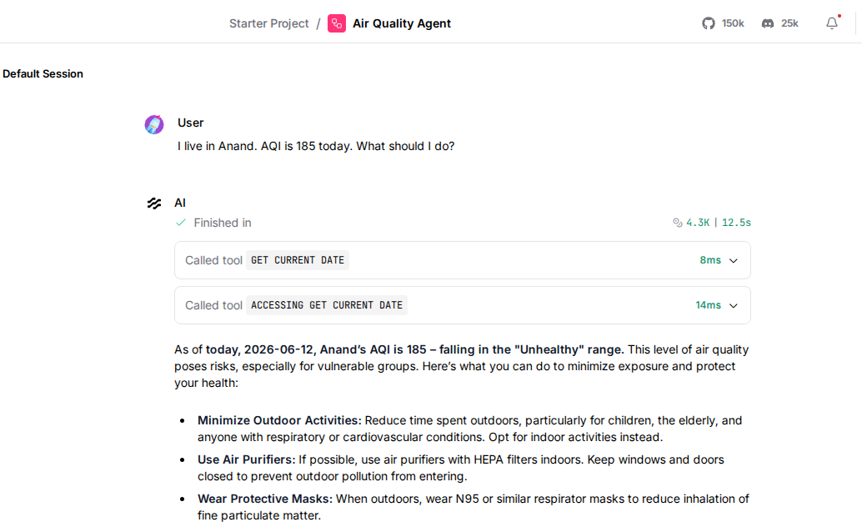
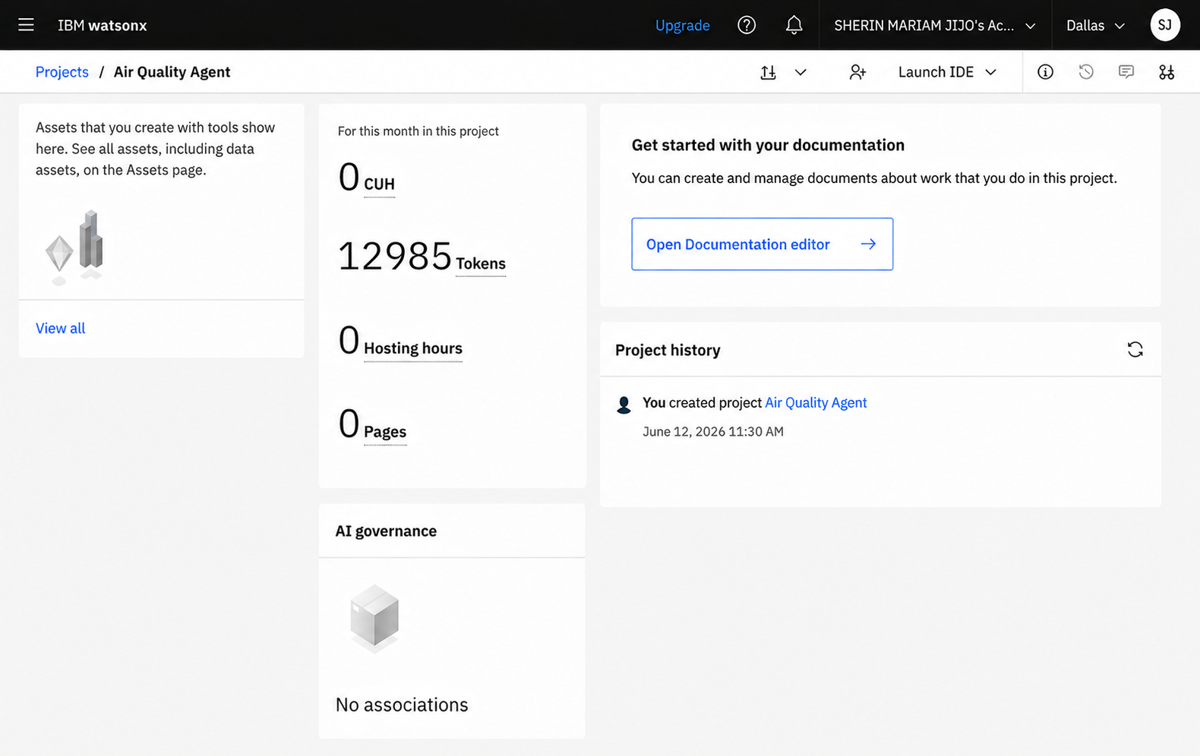
Token Usage
12,985 token are used
·
·
·

Slide 12
Novelty and Uniqueness
Multi-Agent AI architecture
Personalized health recommendations
Predictive AQI alerts
RAG-powered trustworthy responses
Community awareness integration
Real-time environmental intelligence
Scalable IBM ecosystem deployment

Slide 13
Git Hub Link
· Please create public github repository (Enable Add README button while creating repository) with format –
Please test and Paste the working Github URL –https://github.com/sherinjijo/IBM-BVM-FDP
Uploaded following three files into my github repository 1) app.json file , 2) yourproblemstatement.pdf file 3) your projectpresntation.pptx file
·
·
·

Slide 14
Future Scope
Integration with IoT Air Quality Sensors
Smart City Deployment
Wearable Health Monitoring Integration
Multilingual Voice Assistant
Advanced AI Forecasting Models
Regional Policy Recommendation Engine
·
·
·

Slide 15


